Slide 1

Capstone project danone france
Review 3
Members:
Akarsh K J
Chandan Raj
Darshan R
Pulagam Teja
Shyamala Iyer
Vijetha Arya
Mentors:
Sreevidya Raman
Abhishek K S
Co.dx Mentor:
Kashish Antal
Engineering Mentor:
Musunuri Sailaja

Slide 2













AGENDA
Recap
Executive Summary
Feature Selection
Modelling
Co.dx demo

Slide 3
RECAP

Slide 4












PRODUCT ROADMAP
Recap | Executive Summary | Feature Selection | Modelling | Co.dx Demo
Problem Understanding
Review 2
Modelling
EDA
April
Model selection
Test train split
Model validation
Response curves
Industry Understanding
Client Understanding
Problem Understanding
Factor Map
Data Understanding
EDA Insights
Phase 1
Phase 2
02
03
01
02
03
Phase 3
Feature Selection
Co.dx
Final Review
Analysing variables
Removing multi collinear features
Feature combination
Variable transformation
Impact of features
May
Review 1
Wireframe
Blueprint
Feb

Slide 5











PROJECT DETAILS
Recap | Executive Summary | Feature Selection | Modelling | Co.dx Demo
Category
Geography
Sales Channels
Time
Specialized Nutrition
Danone
France
Offline marketing
Digital Marketing
Promotional Marketing
2017-2020(June)
Weekly basis
Win Solutions
Problem Definition- Identify the impact of marketing and provide recommendations to take informed marketing decisions in future
Analytical Solution- Determining an analytical model to improve Danone’s marketing media mix which increases sales revenue
Outcome- Improved marketing budget allocation based on the insights taken from historic data and to achieve high incremental sales
Workflow
Data Understanding
and Pre-processing
EDA
Insights
Blueprint and Wireframe
Model Building and Deployment

Slide 6







EDA- FACTOR Map
Recap | Executive Summary | Feature Selection | Modelling | Co.dx Demo
Online Spends
Offline Spends
Promotional Spends
DVM
Livebirths
Impact of Covid
Holidays
Product
Attribute
Competitor
Intelligence
Marketing and Promotion
Inventory
Macroeconomic Factors
Price
Volume
Competitors price
Marketing spends

Slide 7
EDA insights
Recap | Executive Summary | Feature Selection | Modelling | Co.dx Demo
Variables | Insights
Marketing spends | Increasing in marketing spends results in higher sales. However, after reaching the saturation level, no change is observed.
Pricing | An increase in the product pricing results in a decreased sales
Competitor Spends | An increase in the competitor spends resulted in a decrease in sales of Bledina product
Macro-economics | Sales peaks can be observed when there is an increase in live births and when there is an increase in holidays
Marketing Penetration | Marketing penetration of Bledina has decreased whereas that of its competitor has increased

Slide 8
Executive Summary

Slide 9
Recap | Executive Summary | Feature Selection | Modelling | Co.dx Demo
EXECUTIVE SUMMARY
Sales | Current Spends | Recommended Spends | Current ROI | Recommended ROI
TV | €4.9M | €3.82M | 7.3 | 9.2
Press | €356K | €280K | 8.6 | 10.7
Catch Up TV | €668K | €919K | 23 | 17.3
Data Retailers | €565K | €450K | 6 | 7.4
Programmatic | €2.3M | €1.8M | 7 | 9
Social | €870K | €670K | 11 | 14.6
Direct buying | €223K | €210K | 30 | 32
Promotions | €5.3M | €4.1M | 15 | 18.5
Current
Recommended
Overall Spend
€15M
Overall Spend
€ 12.2M
Incremental Sales
€168M
Incremental Sales
€ 164M
Overall Spend
€ 15M
Overall ROI
11.2
Overall ROI
13.4
Overall Incremental Sales
€ 15M
Overall ROI
€ 15M

Slide 10
Feature SELECTION

Slide 11

Recap | Executive Summary | Feature Selection | Modelling | Co.dx Demo
FEATURE SELECTION
01
03
Applying to the data
Lag effect
Adstock
Log transformation
05
Highly multi-collinear variables were detected by Variance Inflation Factor and removed
REMOVING
MULTI-COLLINEAR FEATURES
ANALYSING ALL VARIABLES
FEATURE EXTRACTION
TRANSFORMING VARIABLES
IMPACT OF FEATURES
Based on EDA we will be considering the variables that are impacting our sales
02
Columns were combined to extract meaningful features
Through several iterations the impact of the model features are estimated
04

Slide 12






Recap | Executive Summary | Feature Selection | Modelling | Co.dx Demo
Features Selected for Modelling
Competition retail non-organic dvm
Competition retail non-organic price
Nestle Total Spends
Competitor Intelligence
Marketing and Promotion
Offline spends:
Bledina total TV spends
Bledina total press spends
Online spends:
Bledina total catchuptv spends
Bledina total data retailer spends
Bledina total programmatic spends
Bledina total social spends
Bledina total direct spends
Promotional spends:
Bledina total promo spends
Holidays
Lockdown
Macroeconomic Factors
Retail total Bledina product DVM
Inventory

Slide 13
Modelling

Slide 14

Understanding of mmx
Recap | Executive Summary | Feature Selection | Modelling | Co.dx Demo
Market Mix Modelling is a statistical technique which estimates the impact of various marketing activities on sales, predicts the impact of the future mix of marketing activities and enables informed marketing plans.
Sales
Base – Sales generated by brand equity
$ln(Y)=ln(β_{0}){+β}_{1}ln(X_{1})+$ $β_{2}ln(X_{2})$
Incremental – Sales generated by marketing activities
Role of various factors
Measure Impact
Contribution - Represents the sales due to each marketing input
Understand the role of each marketing and promotional activities on sales. A 1% increase in the predictor is associated with a Beta% change in the outcome
Return on Investment
Provide Recommendations
Identify opportunities to improve efficiency of marketing and promo spends
Response Curves - Shows the relationship between the Sales and each of the marketing inputs

Slide 15






MODEL CONSTRUCT
Recap | Executive Summary | Feature Selection | Modelling | Co.dx Demo
Lag / Delay Effect
The delayed impact of marketing on sales
Log Transformation
Applying log transform will help us to account for the saturation effect of increasing spends.
Lag
Ad stock
Ad stock
Advertising adstock is a term used for measuring the memory effect carried over from the time of first starting advertisements.
Train 70% data Test 30% data
Multiplicative model
Sales = f ( )
Promotional Spends
Marketing channel spend
Seasonality
External factors

Slide 16
Recap | Executive Summary | Feature Selection | Modelling | Co.dx Demo
STEPS FOLLOWED DURING MODELLING
Model output
Split Data
Build model
Train the Model
Test the model
Iterations
Scores
Features
LOG-LOG REGRESSION
Evaluation metrics

Slide 17
Recap | Executive Summary | Feature Selection | Modelling | Co.dx Demo
ITERATIONS
Variables | Coefficients | P Values | VIF
const | 12.2732 | 0 | 142625.5
Bledina_total_tv_spends | 0.0036 | 0.105 | 1.6
Bledina_total_press_spends | 0.0079 | 0.004 | 1.9
Bledina_total_dataretailers_spends | 0.005 | 0.004 | 1.4
Bledina_total_social_spends | 0.0047 | 0.172 | 1.3
Bledina_total_promo_spends | 0.0101 | 0.004 | 1.3
Variables | Coefficients | P Values | VIF
const | 10.5117 | 0.0 | 76125.8
Bledina_total_tv_spends | 0.0046 | 0.02 | 1.6
Bledina_total_press_spends | 0.0020 | 0.20 | 1.3
Bledina_total_catchup_spends | 0.0030 | 0.13 | 2.3
Bledina_total_dataretailers_spends | 0.0015 | 0.36 | 1.6
Bledina_total_programmatic_spends | 0.0020 | 0.39 | 2.5
Bledina_total_social_spends | 0.0018 | 0.29 | 1.5
Bledina_total_directbuying_spends | 0.0023 | 0.36 | 2.9
Bledina_total_promo_spends | 0.0147 | 0.00 | 1.2
Model Scores:
Model Scores:
R-squared:0.724
Adjusted R-squared:0.691
Train MAPE:0.2448
Test MAPE:0.4508
R-squared:0.63
Adjusted R-squared:0.59
Train MAPE:0.28
Test MAPE: 0.34

Slide 18
Recap | Executive Summary | Feature Selection | Modelling | Co.dx Demo
MODEL VALIDATION

Slide 19
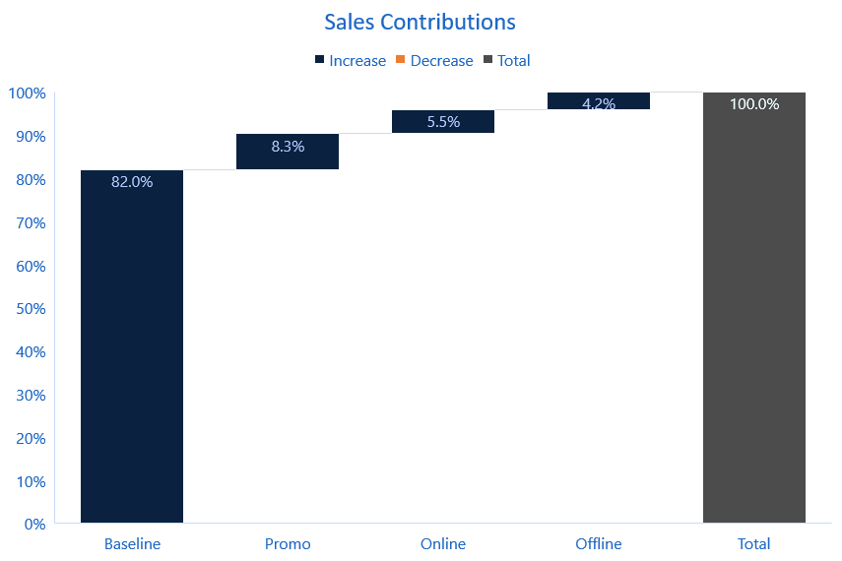
Recap | Executive Summary | Feature Selection | Modelling | Co.dx Demo
WATERFALL CHART
Baseline sales contribution – 82%
Incremental sales contribution – 18%
Promotional Spends has the highest positive contribution

Slide 20
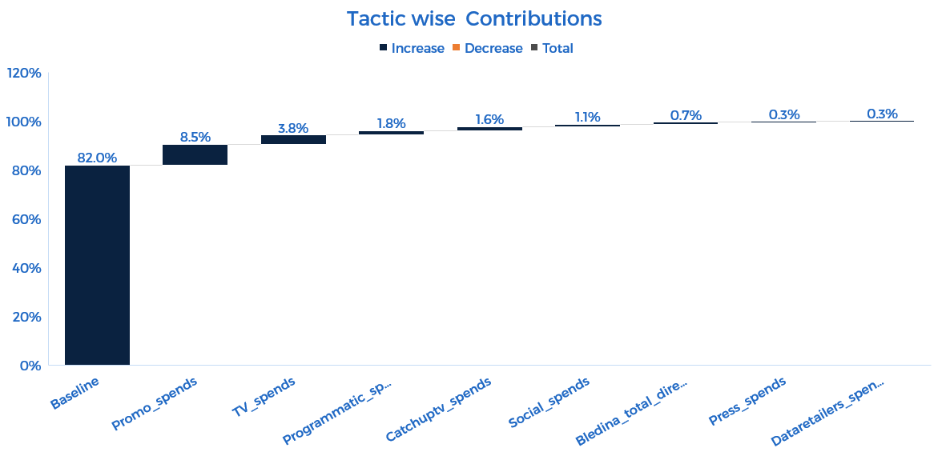
Recap | Executive Summary | Feature Selection | Modelling | Co.dx Demo
WATERFALL CHART

Slide 21
Recap | Executive Summary | Feature Selection | Modelling | Co.dx Demo
RESPONSE CURVES
Recommended Spend Range
Recommended Spend Range
 | Current | Recommended
Spends | 4.9M | 3.82M
Incremental Sales | 36M | 35M
Roi | 7.36 | 9.2
 | Current | Recommended
Spends | €356K | 280K
Incremental Sales | 3.09M | 3.01M
Roi | 8.6 | 10.7

Slide 22
Recap | Executive Summary | Feature Selection | Modelling | Co.dx Demo
RESPONSE CURVES
Recommended Spend Range
Recommended Spend Range
 | Current | Recommended
Spends | €668K | €919K
Incremental Sales | 15.7M | 15.9M
Roi | 23.01 | 17.3
 | Current | Recommended
Spends | €565K | €450K
Incremental Sales | 3.6M | 3.3M
Roi | 6.09 | 7.4

Slide 23
Recap | Executive Summary | Feature Selection | Modelling | Co.dx Demo
RESPONSE CURVES
Recommended Spend Range
Recommended Spend Range
 | Current | Recommended
Spends | €2.3M | €1.8M
Incremental Sales | 16.8M | 16.3M
Roi | 7.1 | 9
 | Current | Recommended
Spends | €870K | €670K
Incremental Sales | 10M | 9.7M
Roi | 11.5 | 14.6

Slide 24
Recap | Executive Summary | Feature Selection | Modelling | Co.dx Demo
RESPONSE CURVES
Recommended Spend Range
 | Current | Recommended
Spends | €223K | €210K
Incremental Sales | 6M | 6M
Roi | 30 | 32
 | Current | Recommended
Spends | €5.1M | €4.1M
Incremental Sales | 79M | 75M
Roi | 15.1 | 18.5

Slide 25
Co.Dx DEMO
CO.DX App Link

Slide 26
THANK YOU
Notes:
So this is it from our end,thank you for your time.

Slide 27
APPENDIX

Slide 28















Marketing tactics are divided into three Channels
Data retailers
Native ads
Offline
Online
Television
Press
Keyword targeting
Catchup TV
Programmatic
Direct buying
Promotional
Seasonal Promotion
E-mails
Search Engine Ads
Social

Slide 29
Marketing spend across channels
€16M
*Breakup of cumulative spends formed by adding spends of all the data from 2017-2020(June).
INSIGHTS
INSIGHTS
There is almost an equal distribution of funds on all the marketing channels when analysed cumulatively for all the three and half years.
In initial years offline and promotional channels were allocated much higher budget than digital but it got reversed over time.

Slide 30
Breakup of online and offline spends
*Breakup of cumulative online and offline spends formed by adding spends of all the data from 2017-2020(June).
INSIGHTS
INSIGHTS
Programmatic takes a major chunk of our online spends.
Keyword and Native ads takes the lowest chunk of our online spends.
Majority of our offline spending is done on TV Ads.

Slide 31


Impact of spends on sales
Correlation:0.26
-1 0 +1
FINDINGS
INSIGHTS
Increase in sales is observed immediately or with a lag whenever there is an increase in marketing spends.
Over the time spends decreased drastically but sales didn’t reduce; This implies spendings done in 2017-18 has its effect even in 2019-20.

Slide 32
Online Vs Offline vs promo spends effect on sales
Correlation:0.42
-1 0 +1
Correlation:0.009
Correlation:0.12
FINDINGS
INSIGHTS
Online spends is having an increasing trend while offline and promotional spendings is having an decreasing trend. Increase in channel spendings causes an increase in sales.
Promotional spends are having an immediate impact on sales than digital or offline.

Slide 33
IMPACT OF PRODUCT PRICE ON SALES
Correlation: -0.18
-1 0 +1
FINDINGS
INSIGHTS
Over the years there was a decrease in sales with the increase in the price of the product
Price of the product plays a crucial role in sales as people tend to prefer more affordable products

Slide 34
Impact of DVM on sales
Correlation: 0.28
-1 0 +1
FINDINGS
INSIGHTS
Bledina DVM increases after some lag whenever a spike in sales is encountered this lag is due to a dip in DVM caused by increased sales.
As Bledina DVM is decreased over time our sales also decreased.

Slide 35
competitors Spends impacts bledina sales
Correlation:0.06
-1 0 +1
FINDINGS
INSIGHTS
Increase in competitors spends impacts Bledina sales immediately or with a lag.
The competitors spends may cause an impact on the expected result of our spendings

Slide 36
Impact of livebirths On sales
Correlation:0.86
-1 0 +1
FINDINGS
INSIGHTS
Sales and Livebirth are having a seasonality:They are dipping in the month of Feb, Aug, Nov and rising in July every year.
The sales is highly dependent upon live-birth as Bledina is a brand for Infant products.

